Slide 1
Chapter 7: Cryptographic Systems
CCNA Security v2.0

Slide 2
Chapter Outline
7.0 Introduction
7.1 Cryptographic Services
7.2 Basic Integrity and Authenticity
7.3 Confidentiality
7.4 Public Key Cryptography
7.5 Summary

Slide 3
Section 7.1: Cryptographic Services
Upon completion of this section, you should be able to:
Explain the requirements of secure communications including integrity, authentication, and confidentiality.
Explain cryptography.
Describe cryptoanalysis.
Describe cryptology.

Slide 4
Topic 7.1.1: Securing Communications
The principles of cryptology can be used to explain how modern day protocols and algorithms are used to secure communications. Cryptology is the science of making and breaking secret codes. The development and use of codes is called cryptography, and breaking codes is called cryptanalysis. Cryptography has been used for centuries to protect secret documents. For example, Julius Caesar used a simple alphabetic cipher to encrypt messages to his generals in the field. His generals would have knowledge of the cipher key required to decrypt the messages.

Slide 5
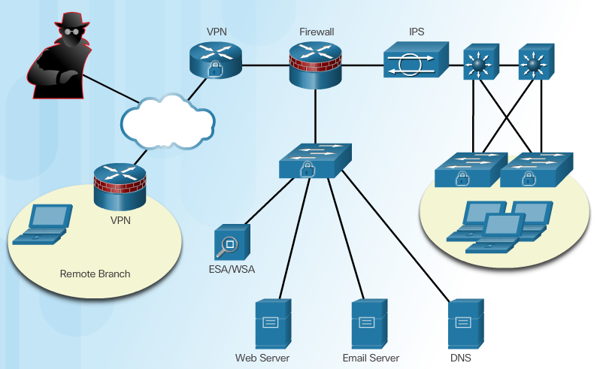
Authentication, Integrity, and Confidentiality
To ensure secure communications across both the public and private infrastructure, the network administrator’s first goal is to secure the network infrastructure, including routers, switches, servers, and hosts.
This can be accomplished using device hardening, AAA access control, ACLs, firewalls, monitoring threats using IPS, securing endpoints using Advanced Malware Protection (AMP), and enforcing email and web security using the Cisco Email Security Appliance (ESA) and Cisco Web Security Appliance (WSA). The figure shows an example of a secure network topology.
Cisco Guide to Harden Cisco IOS Devices
http://www.cisco.com/c/en/us/support/docs/ip/access-lists/13608-21.html
Notes:
7.1.1.1 Authentication, Integrity, and Confidentiality

Slide 6
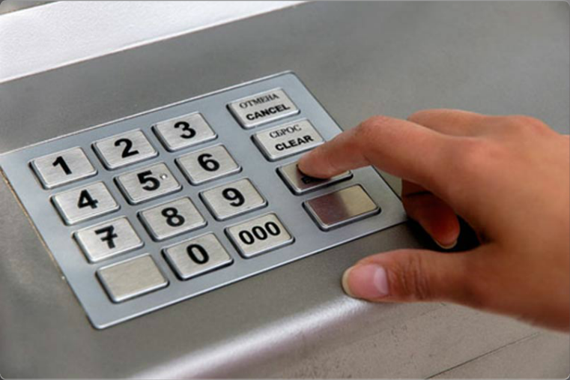
Authentication
There are two primary methods for validating a source in network communications: authentication services and data nonrepudiation services.
Authentication guarantees that a message comes from the source that it claims to come from. Authentication is similar to entering a secure personal identification number (PIN) for banking at an ATM, as shown in the figure.
Data nonrepudiation is a similar service that allows the sender of a message to be uniquely identified. With nonrepudiation services in place, a sender cannot deny having been the source of that message.
Notes:
7.1.1.2 Authentication

Slide 7

Data Integrity
Data integrity ensures that messages are not altered in transit. With data integrity, the receiver can verify that the received message is identical to the sent message and that no manipulation occurred.
European nobility ensured the data integrity of documents by creating a wax seal to close an envelope, as shown in the figure. The seal was often created using a signet ring.
These bore the family crest, initials, a portrait, or a personal symbol or motto of the owner of the signet ring. An unbroken seal on an envelope guaranteed the integrity of its contents. It also guaranteed authenticity based on the unique signet ring impression.
Notes:
7.1.1.3 Data Integrity

Slide 8

Data Confidentiality
Data confidentiality ensures privacy so that only the receiver can read the message. This can be achieved through encryption. Encryption is the process of scrambling data so that it cannot be easily read by unauthorized parties.
When enabling encryption, readable data is called plaintext, or cleartext, while the encrypted version is called encrypted text or ciphertext.
Notes:
7.1.1.4 Data Confidentiality
7.1.1.5 Activity – Identify the Secure Communication Objective

Slide 9
Topic 7.1.2: Cryptography

Slide 10
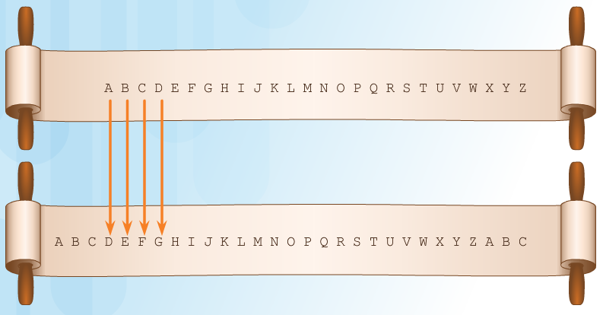
Creating Ciphertext
Ciphertext can be creating using several methods:
Transposition
Substitution
One-time pad
Over the centuries, various cipher methods, physical devices, and aids have been used to encrypt and decrypt text:
Scytale (Figure 1)
Caesar Cipher (Figure 2) - below
Vigenère Cipher (Figure 3)
Enigma Machine (Figure 4)
Notes:
7.1.2.1 Creating Ciphertext

Slide 11

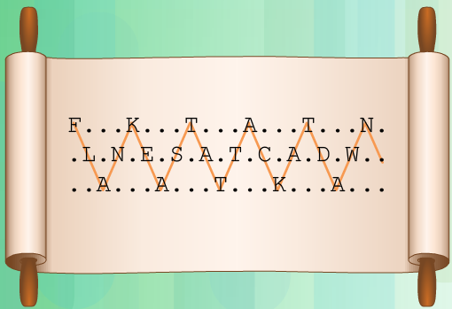
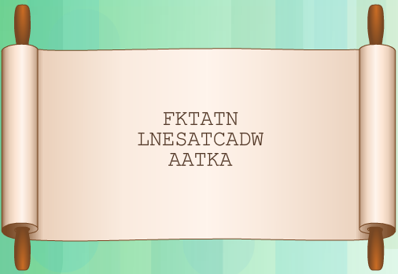
Transposition Ciphers
In transposition ciphers, no letters are replaced; they are simply rearranged. An example of this type of cipher is taking the FLANK EAST ATTACK AT DAWN message and transposing it to read NWAD TAKCATTA TSAE KNALF. In this example, the key is to reverse the letters.
Another example of a transposition cipher is known as the rail fence cipher. In this transposition, the words are spelled out as if they were a rail fence. They are staggered, some in front, some in the middle and some in back, across several parallel lines – as shown below
Notes:
7.1.2.2 Transposition Ciphers

Slide 12

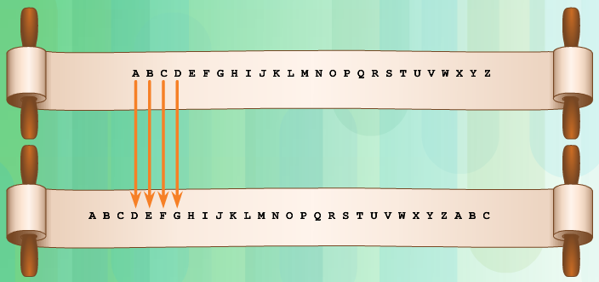

Substitution Ciphers
Substitution ciphers substitute one letter for another. In their simplest form, substitution ciphers retain the letter frequency of the original message.
The Caesar cipher was a simple substitution cipher. For example, refer to the plaintext message in Figure 1. If the key used was 3, the letter A was moved three spaces to the right, resulting in an encoded message that used the letter D in place of the letter A
xxxx
Notes:
7.1.2.3 Substitution Ciphers
7.1.2.4 Substitution Ciphers (Cont.)

Slide 13
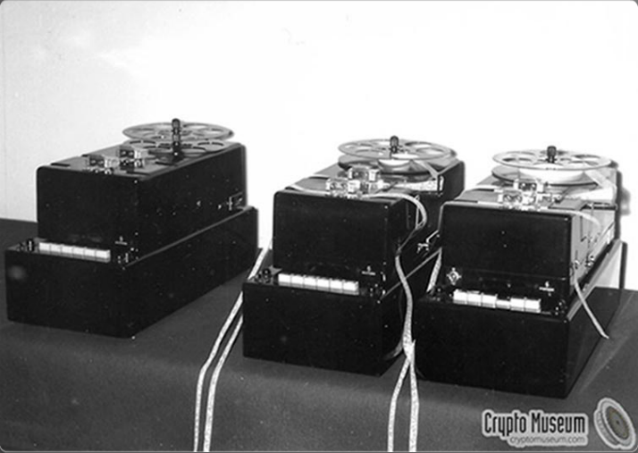
One-Time Pad Ciphers
Gilbert Vernam was an AT&T Bell Labs engineer who, in 1917, invented, and later patented, the stream cipher displayed in Figure 1 (refer to curriculum).
He also co-invented the one-time pad cipher. Vernam proposed a teletype cipher in which a prepared key consisting of an arbitrarily long, non-repeating sequence of numbers was kept on paper tape. It was then combined character by character with the plaintext message to produce the ciphertext. Figure 2 displays an example of a Vernam cipher teletype device.
Notes:
7.1.2.5 One-Time Pad Ciphers

Slide 14
Topic 7.1.3: Cryptanalysis

Slide 15

Cracking Code
For as long as there has been cryptography, there has been cryptanalysis. Cryptanalysis is the practice and study of determining the meaning of encrypted information (cracking the code), without access to the shared secret key.
The figure symbolizes that many keys must be tried before successfully breaking a code.
Notes:
7.1.3.1 Cracking Code

Slide 16
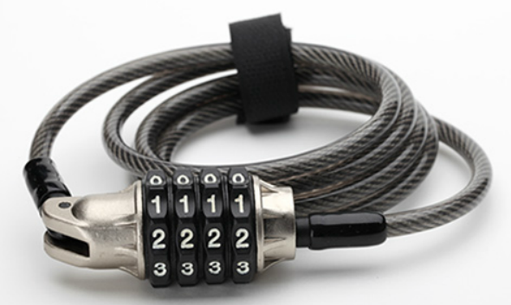
Methods for Cracking Code
Brute-force method - The attacker tries every possible key knowing that eventually one of them will work.
Ciphertext method - The attacker has the ciphertext of several encrypted messages but no knowledge of the underlying plaintext.
Known-Plaintext method - The attacker has access to the ciphertext of several messages and knows something about the plaintext underlying that ciphertext.
Chosen-Plaintext method - The
attacker chooses which data the encryption device encrypts and observes the ciphertext output.
Chosen-Ciphertext method - The attacker can choose different ciphertext to be decrypted and has access to the decrypted plaintext.
Meet-in-the-Middle method - The attacker knows a portion of the plaintext and the corresponding ciphertext.
Methods used for cryptanalysis:
Brute-force method
Ciphertext method
Known-Plaintext method
Chosen-Plaintext method
Chosen-Ciphertext method
Meet-in-the-Middle method
The simplest method to understand is the brute-force method. For example, if a thief attempted to steal a bicycle secured with the combination lock displayed in the figure, they would have to attempt a maximum of 10,000 different possibilities (0000 to 9999). All encryption algorithms are vulnerable to this attack
Notes:
7.1.3.2 Methods for Cracking Code

Slide 17
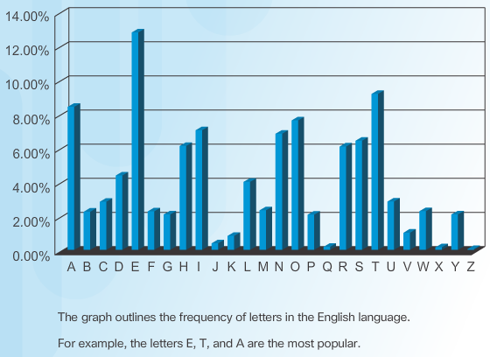
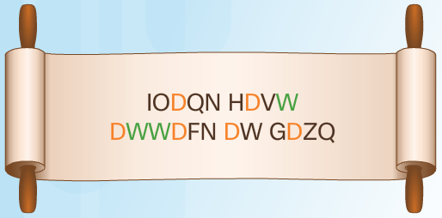
Methods for Cracking Code
Frequency Analysis of the English Alphabet
In the Caesar ciphered message IODQN HDVW DWWDFN DW GDZQ, shown in Figure 2, the cipher letter D appears six times while the cipher letter W appears four times. There is a good possibility that the cipher letters D and W represent either the plaintext E, T or A. In this case, the D represents the letter A, and the W represents the letter T.
Deciphering Using Frequency Analysis
Notes:
7.1.3.3 Cracking Code Example

Slide 18
Topic 7.1.4: Cryptology
Cryptology is the science of making and breaking secret codes. As shown in the figure, cryptology combines two separate disciplines:
Cryptography - the development and use of codes
Cryptanalysis - the breaking of those codes
There is a symbiotic relationship between the two disciplines because each makes the other one stronger. National security organizations employ practitioners of both disciplines and put them to work against each other.

Slide 19
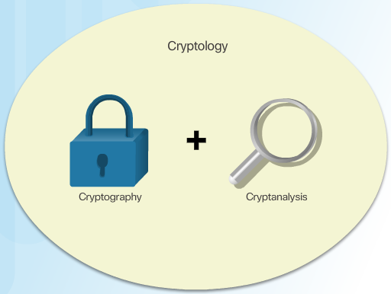
Making and Breaking Secret Codes
Notes:
7.1.4.1 Making and Breaking Secret Codes

Slide 20
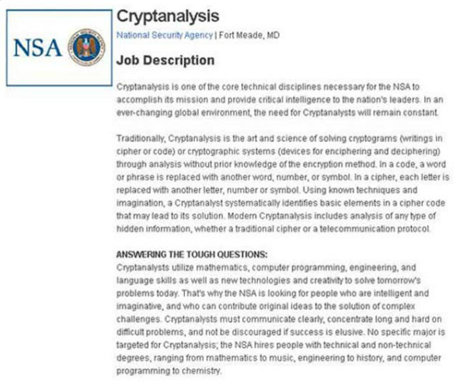
Cryptanalysis
Cryptanalysis is often used by governments in military and diplomatic surveillance, by enterprises in testing the strength of security procedures, and by malicious hackers in exploiting weaknesses in websites.
Cryptanalysts are individuals who perform cryptanalysis to crack secret codes. A sample job description is displayed in the figure
Notes:
7.1.4.2 Cryptanalysis

Slide 21
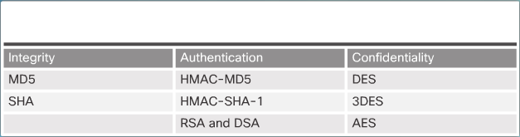
The Secret is in the Keys
In the world of communications and networking, authentication, integrity, and data confidentiality are implemented in many ways using various protocols and algorithms. The choice of protocol and algorithm varies based on the level of security required to meet the goals of the network security policy.
As an example, for message integrity, message-digest 5 (MD5) is faster but less secure than Secure Hash Algorithm 2 (SHA2). Confidentiality can be implemented using DES, 3DES, or the very secure AES. Again, the choice varies depending on the security requirements specified in the network security policy document. The table in the figure lists common cryptographic hashes, protocols, and algorithms
Notes:
7.1.4.3 The Secret is in the Keys
7.1.4.4 Activity – Identify the Cryptology Terminology

Slide 22
Section 7.2: Basic Integrity and Authenticity
Upon completion of the section, you should be able to:
Describe the purpose of cryptographic hashes.
Explain how MD5 and SHA-1 are used to secure data communications.
Describe authenticity with HMAC.
Describe the components of key management.

Slide 23
Topic 7.2.1: Cryptographic Hashes

Slide 24
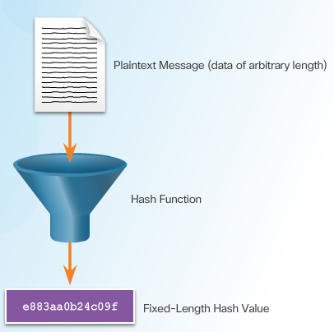
Cryptographic Hash Function
Hashes are used for integrity assurance. As shown in the figure, a hash function takes binary data, called the message, and produces a fixed-length, condensed representation, called the hash. The resulting hash is also sometimes called the message digest, digest, or digital fingerprint.
Hashing is based on a one-way mathematical function that is relatively easy to compute, but significantly harder to reverse. Grinding coffee is a good analogy of a one-way function. It is easy to grind coffee beans, but it is almost impossible to put all of the tiny pieces back together to rebuild the original beans.
Notes:
7.2.1.1 Cryptographic Hash Function

Slide 25
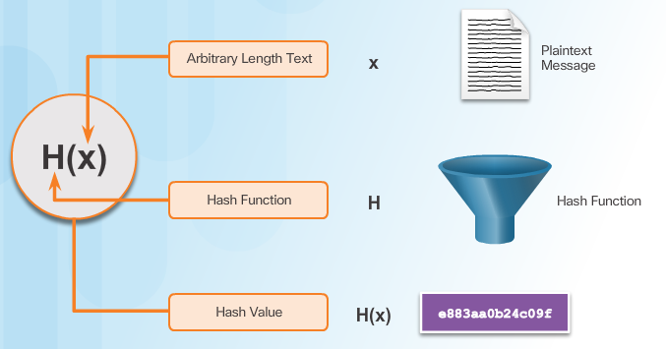
Cryptographic Hash Function Properties
Notes:
7.2.1.2 Cryptographic Hash Function Properties

Slide 26
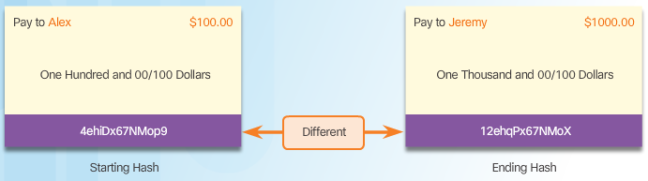
Well-Known Hash Functions
Notes:
7.2.1.3 Well-Known Hash Functions

Slide 27
Topic 7.2.2: Integrity with MD5, SHA-1, and SHA-2

Slide 28
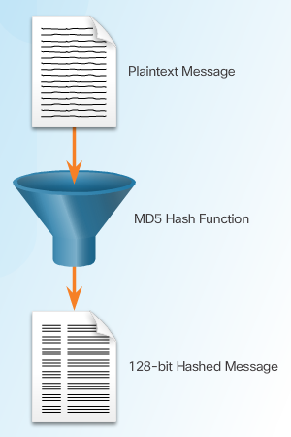
Message Digest 5 Algorithm
The MD5 algorithm is a hashing algorithm that was developed by Ron Rivest and is used in a variety of Internet applications today.
MD5 is a one-way function that makes it easy to compute a hash from the given input data but makes it very difficult to compute input data given only a hash value. MD5 is essentially a complex sequence of simple binary operations, such as exclusive OR (XOR) and rotations, which are performed on input data and produce a 128-bit hashed message digest, as shown in the figure.
MD5 is now considered a legacy algorithm and should be avoided. MD5 should be used only when no better alternatives are available, such as when interoperating with legacy equipment. It is recommended that MD5 be phased out and replaced with a stronger algorithm such as SHA-2.
Notes:
7.2.2.1 Message Digest 5 Algorithm

Slide 29
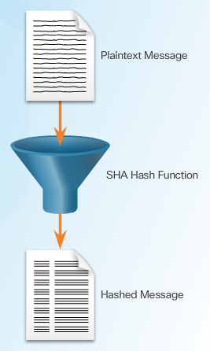
Secure Hash Algorithm
The U.S. National Institute of Standards and Technology (NIST) developed SHA, the algorithm specified in the Secure Hash Standard (SHS). SHA-1, published in 1994, corrected an unpublished flaw in SHA. The SHA design is very similar to the MD5 hash functions that Ron Rivest developed.
The SHA-1 algorithm takes a message of less than 2^64 bits in length and produces a 160-bit message digest. The algorithm is slightly slower than MD5, but the larger message digest makes it more secure against brute-force collision and inversion attacks
Notes:
7.2.2.2 Secure Hash Algorithm

Slide 30
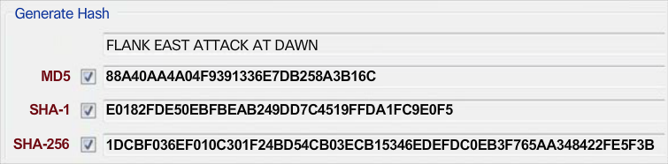
MD5 Versus SHA
Figure 1 displays the resulting hashes of the various hashing algorithms. Remember that the longer the hash values are, the more secure they are.
Both MD5 and SHA-1 are based on a previous version of the message digest algorithm. This makes MD5 and SHA-1 similar in many ways. SHA-1 and SHA-2 are more resistant to brute-force attacks because their digest is at least 32 bits longer than the MD5 digest.
Notes:
7.2.2.3 MD5 Versus SHA

Slide 31
Topic 7.2.3: Authenticity with HMAC

Slide 32
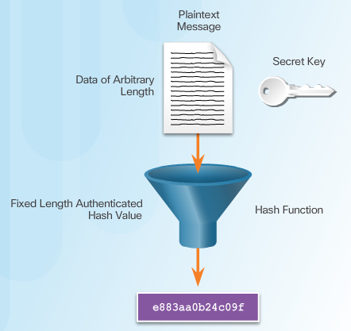
Keyed-Hash Message Authentication Code
In cryptography, a keyed-hash message authentication code (HMAC or KHMAC) is a type of message authentication code (MAC). HMACs use an additional secret key as input to the hash function.
This adds authentication to integrity assurance. An HMAC is calculated using a specific algorithm that combines a cryptographic hash function with a secret key, as shown in the figure. Hash functions are the basis of the protection mechanism of HMACs.
Notes:
7.2.3.1 Keyed-Hash Message Authentication Code

Slide 33
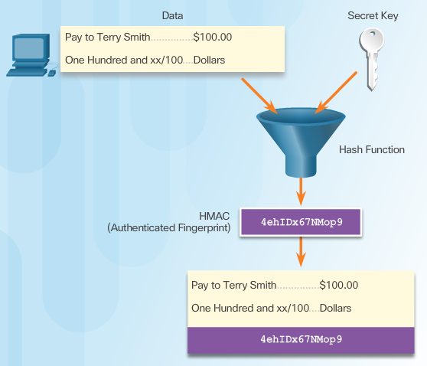
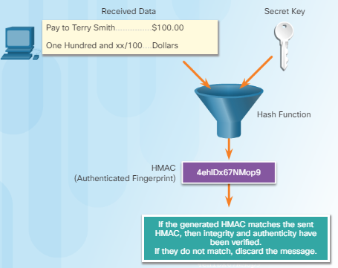
HMAC Operation
Notes:
7.2.3.2 HMAC Operation

Slide 34
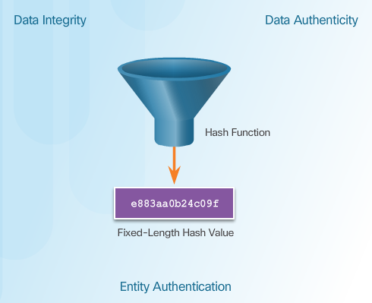
Hashing in Cisco Products
As shown in the figure, Cisco products use hashing for entity authentication, data integrity, and data authenticity purposes:
Cisco IOS routers use hashing with secret keys in an HMAC-like manner to add authentication information to routing protocol updates.
IPsec gateways and clients use hashing algorithms, such as MD5 and SHA-1 in HMAC mode, to provide packet integrity and authenticity.
Cisco software images that are downloaded from Cisco.com have an MD5-based checksum available so that customers can check the integrity of downloaded images.
Notes:
7.2.3.3 Hashing in Cisco Products

Slide 35
Topic 7.2.4: Key Management

Slide 36
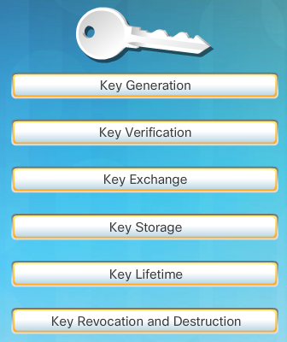
Characteristics of Key Management
As shown in the figure, there are several essential characteristics of key management to consider.
Notes:
7.2.4.1 Characteristics of Key Management

Slide 37
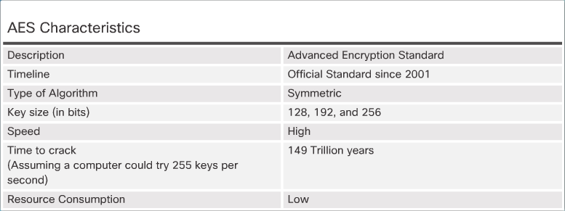
Key Length and Keyspace
Two terms that are used to describe keys are:
Key length - Also called the key size, this is the measure in bits. In this course, we will use the term key length.
Keyspace - This is the number of possibilities that can be generated by a specific key length.
Notes:
7.2.4.2 Key Size and Keyspace

Slide 38
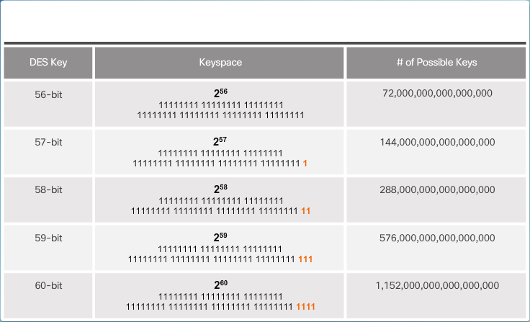
The Keyspace
The keyspace of an algorithm is the set of all possible key values. A key that has n bits produces a keyspace that has 2^n possible key values. By adding one bit to the key, the keyspace is effectively doubled
Notes:
7.2.4.3 The Keyspace

Slide 39
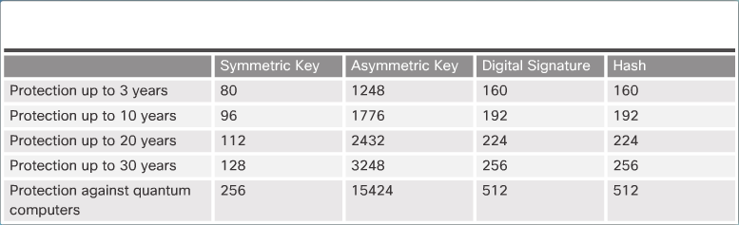
Types of Cryptographic Keys
Several types of cryptographic keys can be generated:
Symmetric keys - Can be exchanged between two routers supporting a VPN
Asymmetric keys - Are used in secure HTTPS applications
Digital signatures - Are used when connecting to a secure website
Hash keys - Are used in symmetric and asymmetric key generation, digital signatures, and other types of applications
Types of cryptographic keys:
Symmetric keys
Asymmetric keys
Digital signatures
Hash keys
Notes:
7.2.4.4 Types of Cryptographic Keys

Slide 40
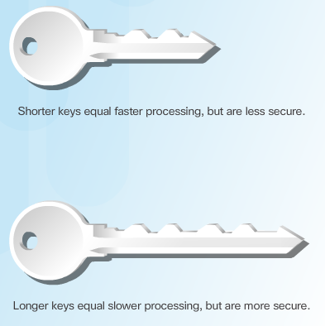
Choosing Cryptographic Keys
Performance is another issue that can influence the choice of a key length. An administrator must find a good balance between the speed and protective strength of an algorithm, because some algorithms, such as the Rivest, Shamir, and Adleman (RSA) algorithm, run slowly due to large key lengths. Strive for adequate protection, while enabling communication over untrusted networks.
Notes:
7.2.4.5 Choosing Cryptographic Keys
7.2.4.6 Activity – Identify the Characteristics of Key Management

Slide 41
Section 7.3: Confidentiality
Upon completion of the section, you should be able to:
Explain how encryption algorithms provide confidentiality.
Explain the function of the DES, 3DES, and the AES algorithms .
Describe the function of the Software Encrypted Algorithm (SEAL) and the Rivest ciphers (RC) algorithms.

Slide 42
Topic 7.3.1: Encryption

Slide 43
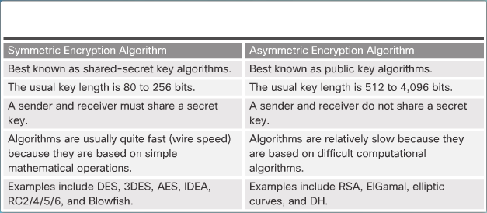
Two Classes of Encryption Algorithms
Notes:
7.3.1.1 Two Classes of Encryption Algorithms

Slide 44
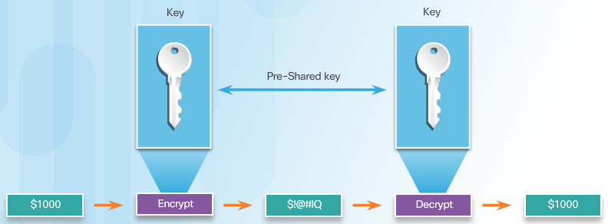
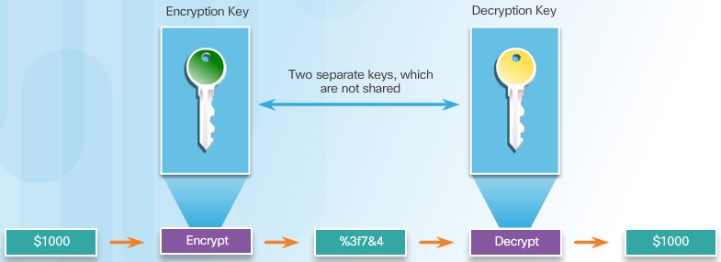
Symmetric and Asymmetric Encryption
Notes:
7.3.1.2 Symmetric and Asymmetric Encryption

Slide 45
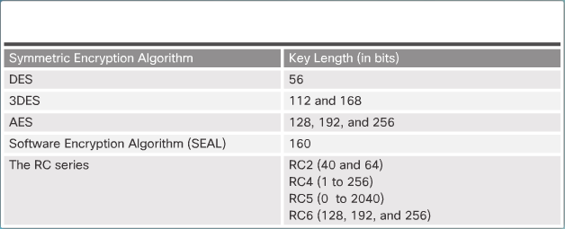
Symmetric Encryption
DES, 3DES, AES, Software Encryption Algorithm (SEAL), and the Rivest ciphers (RC) series, which includes RC2, RC4, RC5, and RC6, are all well-known encryption algorithms that use symmetric keys. The figure highlights common encryption algorithms and their key lengths.
Note: There are many other symmetric encryption algorithms, such as Blowfish, Twofish, Threefish, and Serpent. However, these protocols are either not supported on Cisco platforms or have yet to gain wide acceptance.
Notes:
7.3.1.3 Symmetric Encryption

Slide 46
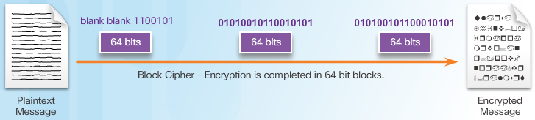
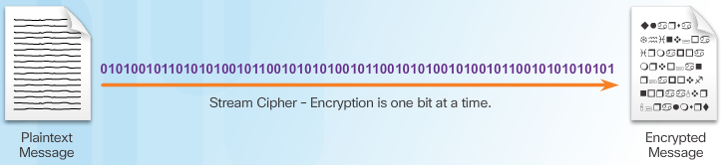
Symmetric Block Ciphers and Stream Ciphers
Notes:
7.3.1.4 Symmetric Block Ciphers and Stream Ciphers

Slide 47
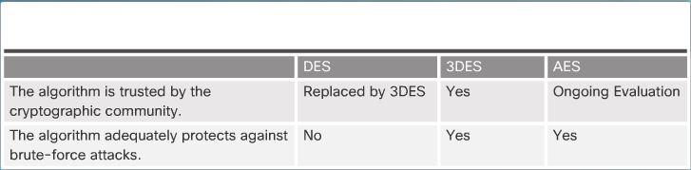
Choosing an Encryption Algorithm
Notes:
7.3.1.5 Choosing an Encryption Algorithm
7.3.1.6 Activity – Compare Symmetric and Asymmetric Encryption Algorithms

Slide 48
Topic 7.3.2: Data Encryption Standard

Slide 49
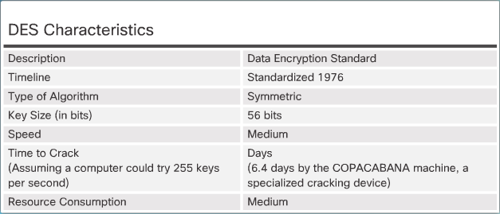
DES Symmetric Encryption
Data Encryption Standard (DES) is a legacy symmetric encryption algorithm that usually operates in block mode by encrypting data in 64-bit blocks. The DES algorithm is essentially a sequence of permutations and substitutions of data bits combined with an encryption key. The same algorithm and key are used for encryption and decryption.
Notes:
7.3.2.1 DES Symmetric Encryption

Slide 50
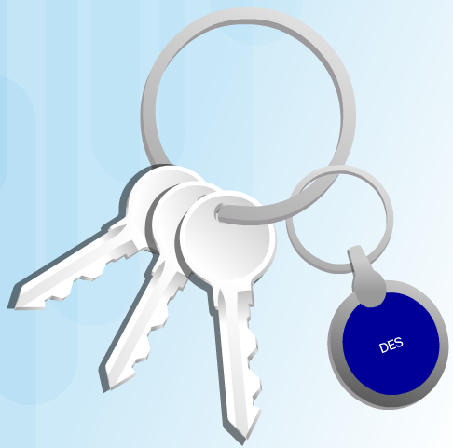
DES Summary
Note: Because of its short key length, DES is acceptable to protect data for a very short time. When possible, use 3DES or AES as they provide more security to protect data.
Notes:
7.3.2.2 DES Summary

Slide 51
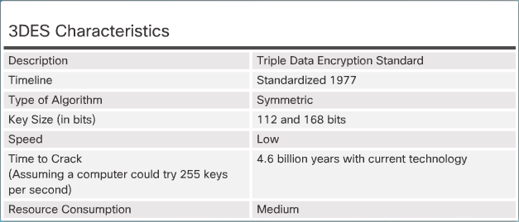
Improving DES with 3DES
Notes:
7.3.2.3 Improving DES with 3DES

Slide 52
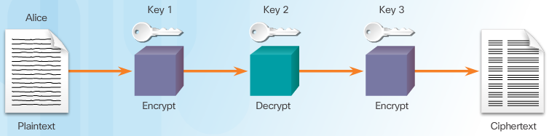
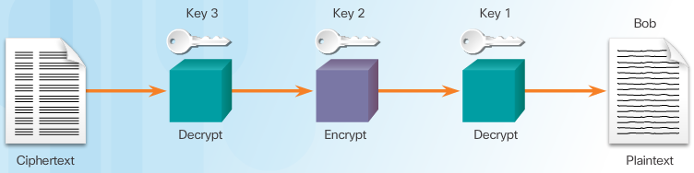
3DES Operation
3DES uses a method called 3DES-Encrypt-Decrypt-Encrypt (3DES-EDE) to encrypt plaintext.
Notes:
7.3.2.4 3DES Operation

Slide 53
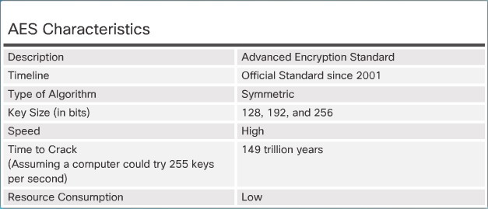
AES Origins
In 1997, the AES initiative was announced, and the public was invited to propose encryption schemes to replace DES. After a five-year standardization process in which 15 competing designs were presented and evaluated, the U.S. National Institute of Standards and Technology (NIST) selected the Rijndael block cipher as the AES algorithm.
Notes:
7.3.2.5 AES Origins

Slide 54
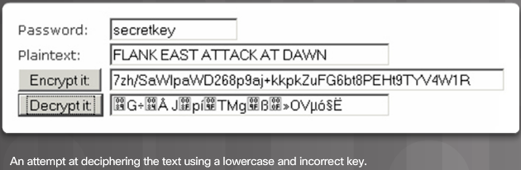
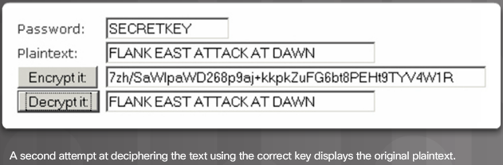
AES Summary
AES was chosen to replace DES for a number of reasons. The key length of AES makes the key much stronger than DES. AES runs faster than 3DES on comparable hardware. AES is more efficient than DES and 3DES on comparable hardware, usually by a factor of five when it is compared with DES. AES is more suitable for high-throughput, low-latency environments, especially if pure software encryption is used.
Notes:
7.3.2.6 AES Summary

Slide 55
Topic 7.3.3: Alternate Encryption Algorithms

Slide 56
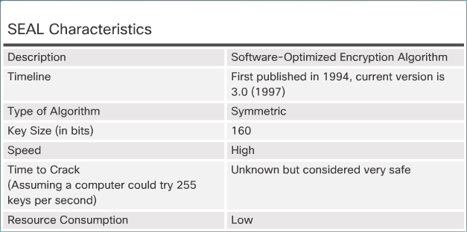
Software-Optimized Encryption Algorithm (SEAL)
SEAL has several restrictions:
The Cisco router and the peer must support IPsec.
The Cisco router and the other peer must run an IOS image that supports encryption.
The router and the peer must not have hardware IPsec encryption.
SEAL has a lower impact on the CPU compared to other software-based algorithms. However, it has a longer initialization phase during which a large set of tables is created using SHA.
Notes:
7.3.3.1 Software-Optimized Encryption Algorithm (SEAL)

Slide 57
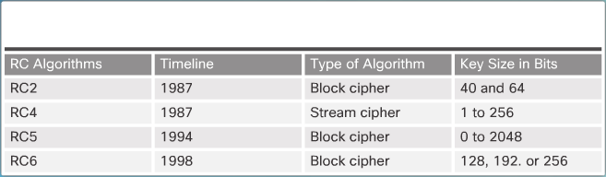
RC Algorithms
The RC algorithms were designed all or in part by Ronald Rivest, who also invented MD5. The RC algorithms are widely deployed in many networking applications because of their favorable speed and variable key-length capabilities.
Notes:
7.3.3.2 RC Algorithms

Slide 58
Topic 7.3.4: Diffie-Hellman Key Exchange

Slide 59
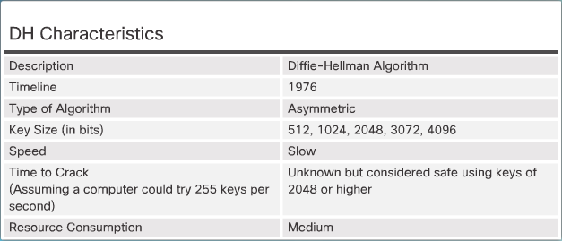
Diffie-Hellman (DH) Algorithm
Whitfield Diffie and Martin Hellman invented the Diffie-Hellman (DH) algorithm in 1976. The DH algorithm is the basis of most modern automatic key exchange methods, and is one of the most common protocols used in networking today. Diffie-Hellman is not an encryption mechanism and is not typically used to encrypt data. Instead, it is a method to securely exchange the keys that encrypt data.
Notes:
7.3.4.1 Diffie-Hellman (DH) Algorithm

Slide 60
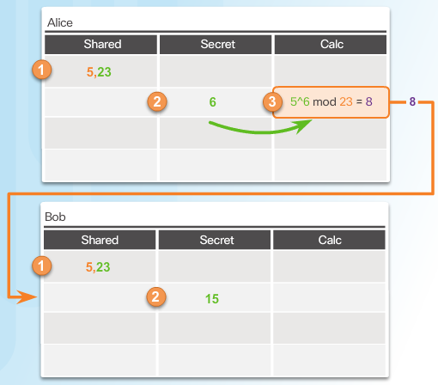
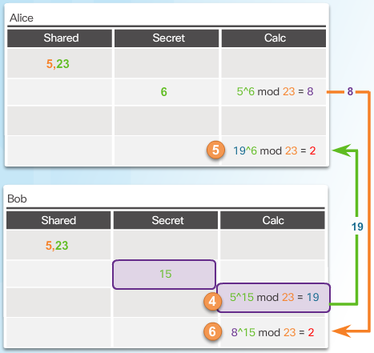
DH Operation
Alice and Bob both come up with the same result (2). This new value is now a shared secret between Alice and Bob and can be used by an encryption algorithm as a shared secret key between them.
Notes:
7.3.4.2 DH Operation
7.3.4.3 Activity – Identify the Steps of the DH Process

Slide 61
Section 7.4: Public Key Cryptography
Upon completion of the section, you should be able to:
Explain the differences between symmetric and asymmetric encryptions and their intended applications.
Explain the functionality of digital signatures.
Explain the principles of a public key infrastructure (PKI).

Slide 62
Topic 7.4.1: Symmetric Versus Asymmetric Encryption

Slide 63
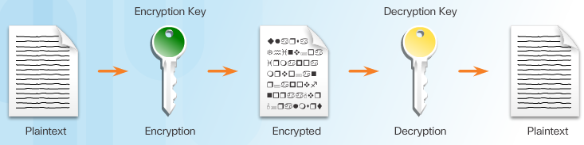
Asymmetric Key Algorithms
Four protocols that use asymmetric key algorithms:
Internet Key Exchange (IKE)
Secure Socket Layer (SSL)
Secure Shell (SSH)
Pretty Good Privacy (PGP)
Asymmetric algorithms, also called public-key algorithms, are designed so that the key that is used for encryption is different from the key that is used for decryption. The decryption key cannot, in any reasonable amount of time, be calculated from the encryption key and vice versa.
Notes:
7.4.1.1 Asymmetric Key Algorithms

Slide 64
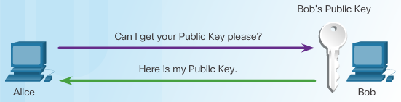
Public Key + Private Key = Confidentiality
When the public key is used to encrypt the data, the private key must be used to decrypt the data. Only one host has the private key; therefore, confidentiality is achieved.
If the private key is compromised, another key pair must be generated to replace the compromised key.
For example, in Figure 1, Alice requests and obtains Bob’s public key.
Notes:
7.4.1.2 Public Key + Private Key = Confidentiality

Slide 65


Private Key + Public Key = Confidentiality
Bob’s Public Key
Bob’s Private Key
In Figure 2, Alice uses Bob’s public key to encrypt a message using an agreed-upon algorithm. Alice sends the encrypted message to Bob.
Bob then uses his private key to decrypt the message as shown in Figure 3.
Notes:
7.4.1.3 Private Key + Public Key = Authenticity

Slide 66

Private Key + Public Key = Authenticity
Notes:
7.4.1.3 Private Key + Public Key = Authenticity

Slide 67


Asymmetric Algorithms
Alice Encrypts Message Using Bob’s Public Key
Alice Encrypts A Hash Using Bob’s Public Key
Notes:
7.4.1.4 Asymmetric Algorithms

Slide 68


Asymmetric Algorithms
Bob Uses Alice’s Public Key to Decrypt Hash
Bob Uses His Public Key to Decrypt Message
Notes:
7.4.1.4 Asymmetric Algorithms (Cont.)

Slide 69

Types of Asymmetric Algorithms
Notes:
7.4.1.5 Types of Asymmetric Algorithms
7.4.1.6 Activity – Identify the Key Types Required to Provide Authenticity and Confidentiality

Slide 70
Topic 7.4.2: Digital Signatures

Slide 71

Using Digital Signatures
Digital signatures have specific properties that enable entity authentication and data integrity as shown in Figure 2.
Digital Signature Properties:
Signature is authentic
Signature is unalterable
Signature is not reusable
Signature cannot be repudiated
Notes:
7.4.2.1 Using Digital Signatures

Slide 72
Code Signing
Digitally signing code provides several assurances about the code:
The code is authentic and is actually sourced by the publisher.
The code has not been modified since it left the software publisher.
The publisher undeniably published the code.
Notes:
7.4.2.2 Code Signing

Slide 73

Digital Certificates
A digital certificate is equivalent to an electronic passport. They enable users, hosts, and organizations to securely exchange information over the Internet. Specifically, a digital certificate is used to authenticate and verify that a user sending a message is who they claim to be. Digital certificates can also be used to provide confidentiality for the receiver with the means to encrypt a reply.
Notes:
7.4.2.3 Digital Certificates

Slide 74


Using Digital Certificates
Sending a Digital Certificate
Receiving a Digital Certificate
Notes:
7.4.2.4 Using Digital Certificates

Slide 75


Digital Signature Algorithms
DSA Scorecard
RSA Scorecard
Notes:
7.4.2.5 Digital Signature Algorithms
7.4.2.6 Activity – Compare Code Signing and Digital Certificates

Slide 76
Topic 7.4.3: Public Key Infrastructure

Slide 77

Public Key Infrastructure Overview
On the Internet, continually exchanging identification between all parties would be impractical. Therefore, individuals agree to accept the word of a neutral third party. Presumably, the third party does an in-depth investigation prior to the issuance of credentials. After this in-depth investigation, the third party issues credentials that are difficult to forge. From that point forward, all individuals who trust the third party simply accept the credentials that the third party issues.
Notes:
7.4.3.1 Public Key Infrastructure Overview

Slide 78


PKI Framework
Elements of the PKI Framework
PKI Example
Notes:
7.4.3.2 PKI Framework

Slide 79

Certificate Authorities
Many vendors provide CA servers as a managed service or as an end-user product, including Symantec Group (VeriSign), Comodo, Go Daddy Group, GlobalSign, DigiCert, and others.
CAs, especially those that are outsourced, can issue certificates of a number of classes, which determine how trusted a certificate is. Figure 1 provides a description of the classes.
Notes:
7.4.3.3 Certificate Authorities

Slide 80

Interoperability of Different PKI Vendors
Interoperability between a PKI and its supporting services, such as Lightweight Directory Access Protocol (LDAP) and X.500 directories, is a concern because many CA vendors have proposed and implemented proprietary solutions instead of waiting for standards to develop.
Note: LDAP and X.500 are protocols that are used to query a directory service, such as Microsoft Active Directory, to verify a username and password.
To address this interoperability concern, the IETF formed the PKI X.509 (PKIX) workgroup, which is dedicated to promoting and standardizing PKI on the Internet. This workgroup has published the Internet X.509 Public Key Infrastructure Certificate Policy and Certification Practices Framework (RFC2527).
Notes:
7.4.3.4 Interoperability of Different PKI Vendors

Slide 81

Public-Key Cryptography Standards
Another important set of PKI standards are the Public-Key Cryptography Standards (PKCS). PKCS refers to a group of Public Key Cryptography Standards devised and published by RSA Laboratories. PKCS provides basic interoperability of applications that use public-key cryptography. PKCS defines the low-level formats for the secure exchange of arbitrary data, such as an encrypted piece of data or a signed piece of data.
Notes:
7.4.3.5 Public-Key Cryptography Standards

Slide 82

Simple Certificate Enrollment Protocol
Notes:
7.4.3.6 Simple Certificate Enrollment Protocol

Slide 83



PKI Topologies
Cross-certified CA topologies - As shown in Figure 2, this is a peer-to-peer model in which individual CAs establish trust relationships with other CAs by cross-certifying CA certificates. Users in either CA domain are also assured that they can trust each other. This provides redundancy and eliminates the single-point of failure.
Single-Root PKI Topology
Hierarchical CA topologies - As shown in Figure 3, the highest level CA is called the root CA. It can issue certificates to end users and to a subordinate CA. The sub-CAs could be created to support various business units, domains, or communities of trust. The root CA maintains the established “community of trust” by ensuring that each entity in the hierarchy conforms to a minimum set of practices.
PKIs can form different topologies of trust. The simplest is the single-root PKI topology shown in Figure 1. A single CA, called the root CA, issues all the certificates to the end users, which are usually within the same organization. The benefit to this approach is its simplicity. However, it is difficult to scale to a large environment because it requires a strictly centralized administration, which creates a single point of failure.
Cross Certified CA
Hierarchical CA
Notes:
7.4.3.7 PKI Topologies

Slide 84

Registration Authority
Notes:
7.4.3.8 Registration Authority

Slide 85


Digital Certificates and CAs
Retrieving CA Certificates
Submitting Certificate Requests to the CA
Notes:
7.4.3.9 Digital Certificates and CAs

Slide 86

Digital Certificates and CAs
Peers Authenticate Each Other
Notes:
7.4.3.9 Digital Certificates and CAs (Cont.)
7.4.3.10 Activity – Identify Elements of the PKI Framework

Slide 87
Section 7.5: Summary
Chapter Objectives:
Explain the areas of cryptology.
Explain to two kinds of encryption algorithms.
Notes:
7.5.1.1 Video Demonstration – Wireshark Packet Sniffing Usernames, Password, and Web Pages
7.5.1.2 Lab – Exploring Encryption Methods
7.5.1.3 Summary

Slide 89


Instructor Resources
Remember, there are helpful tutorials and user guides available via your NetSpace home page. (https://www.netacad.com)
These resources cover a variety of topics including navigation, assessments, and assignments.
A screenshot has been provided here highlighting the tutorials related to activating exams, managing assessments, and creating quizzes.
1
2
Notes:
https://www.netacad.com

